Slide 1

AI-Powered Interactive Learning Assistant for Classrooms
Team Name : Tricore
Team Members:
Bharath. S R
Bhavya. M
K. Sanjana

Slide 2
PROJECT VISION AND OBJECTIVES
Vision: To create an intelligent, multimodal AI assistant that acts as an interactive learning partner for students.
Key Objectives: Improve student engagement through real-time interaction. Support diverse learning styles (text, voice, visuals).Provide instant answers to contextual and general knowledge questions.(Future) Adapt to student needs by sensing engagement/confusion.

Slide 3

THE PROBLEM /NEED
Modern classrooms often lack dynamic, real-time tools to address individual student queries instantly. Varying learning paces and styles can be challenging to cater to simultaneously. Opportunity to leverage AI for personalized and interactive learning support.

Slide 4
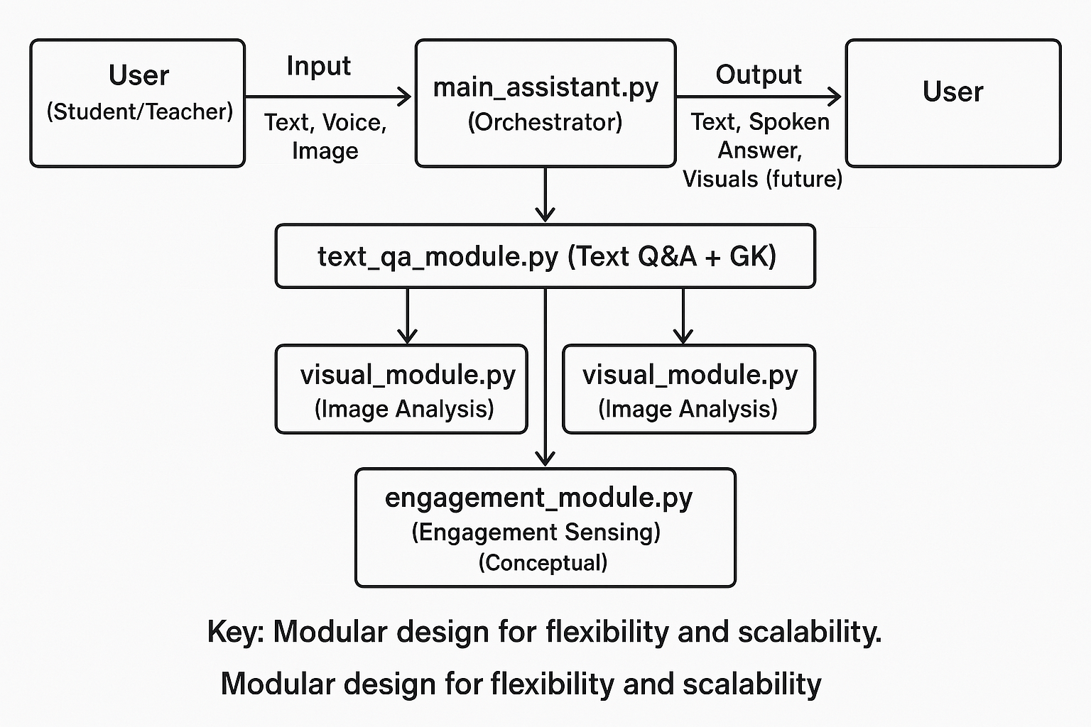
SYSTEM ARCHITECTURE-OVERVIEW

Slide 5
CORE MODULE-TEXT QUESTION ANSWERING (text_qa_module.py)
Dual Capability
Contextual QA
Model: distilbert-base-cased-distilled-squad (Hugging Face).
Function: Extracts answers from your provided text (e.g., lecture notes, articles).
General Knowledge (GK) Fallback
Function: Answers common predefined questions if no specific context is given or if the contextual model fails.
Examples: "what is ai?", "what is photosynthesis? "Demonstrates: Ability to handle both specific and general queries.

Slide 6
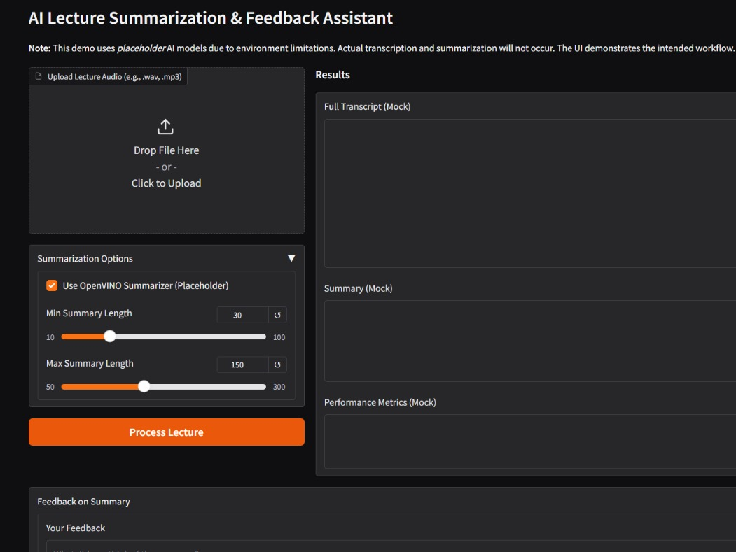
OTHER KEY MODULES & TECHNOLOGIES
voice_processing_module.py:
Speech-to-Text (speech_recognition library).
Text-to-Speech (pyttsx3 library).
Enables hands-free interaction.
visual_module.py:
Image analysis (OpenCV for basics, Hugging Face BLIP model for image captioning).
Allows queries related to visual content (e.g., "Describe this image").
engagement_module.py (Conceptual/Future):
Planned: Face detection (OpenCV Haar) & Emotion Recognition (fer library).
Goal: Infer student engagement/confusion to adapt teaching.

Slide 7
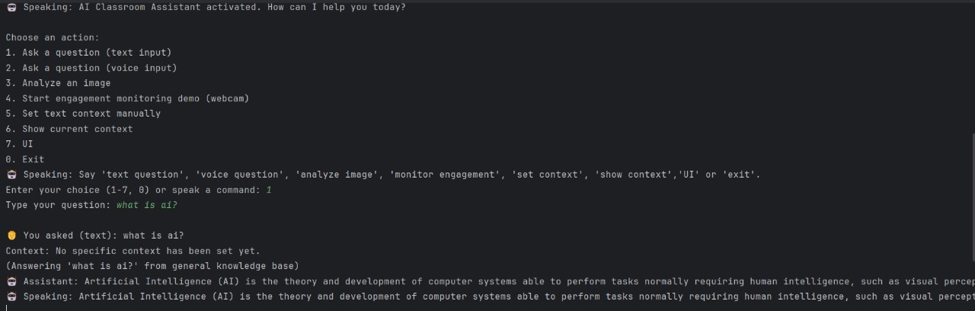
CURRENT STATUS & LIVE DEMO HIGHLIGHTS
What's Working (based on your local setup):
Successful loading of core AI models (DistilBERT QA, BLIP Captioning).STT/TTS initialization.
Live Demo Point 1 (General Knowledge): Ask a GK question (e.g., "what is ai?") with no context set.
Live Demo Point 2 (Contextual QA): Set a specific text context, then ask a question from that context.
Live Demo Point 3 (GK Fallback): With context set, ask a different GK question not in the context.
Live Demo Point 4 (Image Captioning): Analyze an image and show the caption.

Slide 8
CHALLENGES FACED
Difficulty installing AI libraries and managing OS compatibility
Webcam/microphone instability and high CPU usage without GPU support
Delay in voice processing and issues syncing text, voice, and image inputs
Engagement module setup problems (e.g., fer library, webcam permissions)
Use virtual environments, optimize models (OpenVINO), and implement input fallbacks

Slide 9
FUTURE ENHANCEMENTS & ROADMAP
Immediate:Fully implement and test the Engagement Monitoring module. Stabilize webcam/visual input. Improve error handling and your feedback.
Medium-Term:
Develop a Graphical User Interface (GUI): Using Gradio or Streamlit for better usability.
OpenVINO™ Optimization: Convert models for enhanced performance on Intel® hardware. Richer multimodal responses (e.g., generating charts).
Long-Term: Advanced Visual Question Answering (VQA).Persistent memory/learning for personalization. Integration with Learning Management Systems (LMS).

Slide 10
CONCLUSION & Q&A
Developed an AI assistant for classrooms using text, voice, and image input
Enhances learning with real-time, personalized support
Reduces teacher workload by handling routine queries
Successfully implemented QA, speech, and visual modules
Future plans include engagement sensing, GUI, and model optimization
Ready for feedback, suggestions, and real-world use cases.

